Slide 1






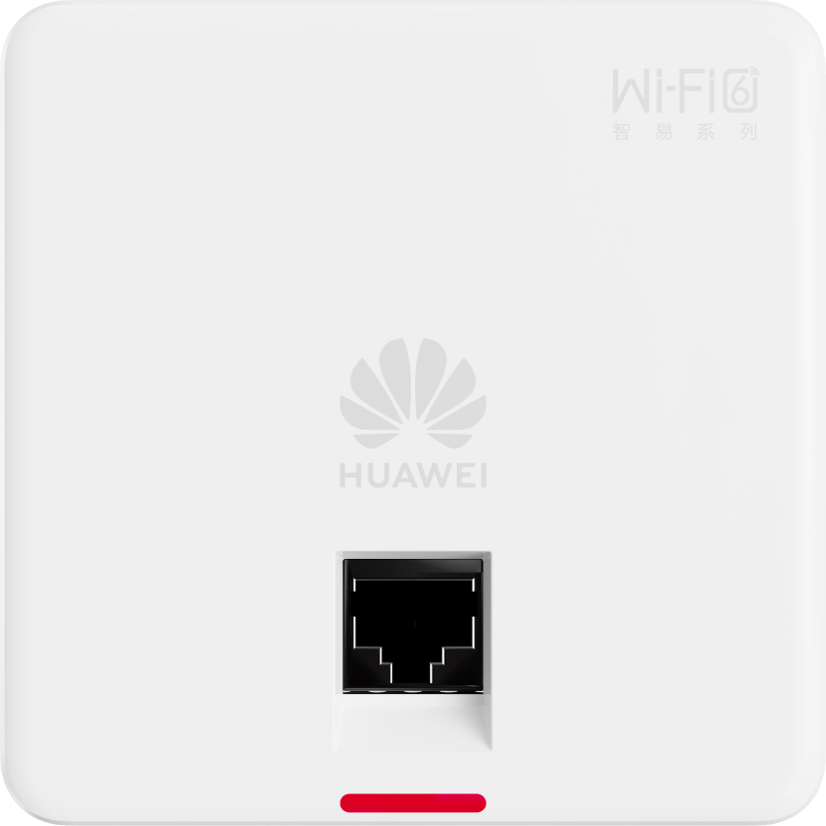
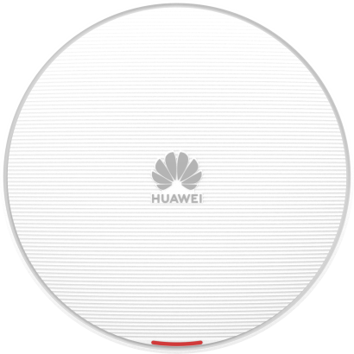
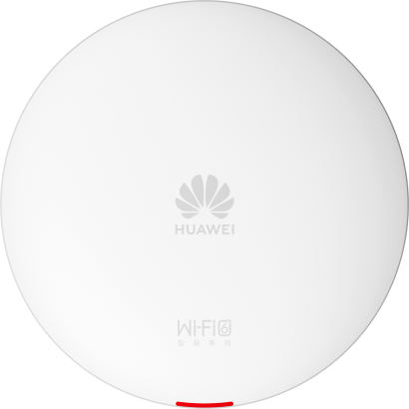


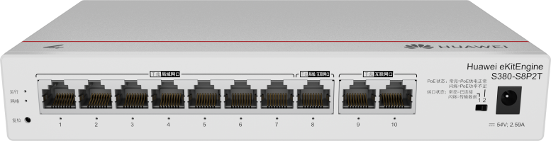
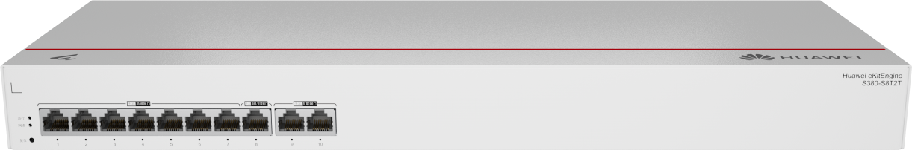


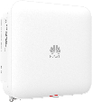






HUAWEI eKit SME Network Products: Sleek Appearance and High Quality
Enterprise Office
Budget hotels
Retail stores
Small- and medium-sized education institutions
Small Factory
SOHO Office
Network egress
Network core/aggregation
Network access
All Scenarios Wi-Fi
S310/S310S
S110
Indoor High-density AP
Indoor Settled AP
AR700/AR300/S380
S620/S530
S220/S220S
Outdoor AP
Wall Plate AP
Excellent performance, 1.5X the industry
forwarding rate
Enhanced stacking, 2x the
network stability
Perpetual PoE, continuous power supply during device restart
Smart antennas, with a 20%
longer coverage
Easy O&M
Sleek appearance
Solid quality
The HUAWEI eKit App/SNC can be used for deployment and O&M of network-wide devices
Failure rate 1/3 of the industry average after 8 + 66 strict tests
Red Dot Design Award, Germany

Slide 2


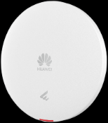
Cost-Effective Settled AP — eKitEngine AP361: Cashier always online
AP361
AP361
* Suitable for Store, Home office and more
Customer Benefit
Cashier Netwrok guaranteed
Module-level AI self-healing + intelligent optimization of the Yujia platform, improving network stability and optimization
Smart saving, Premium performance
Wi-Fi 6
Wi-Fi 5
HUAWEI
1800M
1200M
Industry
20M+/ User
10M/ User
Stable network connection during movement
Smart antenna, signals move with users, ensuring optimal performance at all times. Smart roaming adapts to both static and mobile scenarios.

Slide 3

Settled AP — eKitEngine AP362: Dual-band Wi-Fi 6
AP362
AP362
* Suitable for Store, SME office and more
Customer Benefit
Dual-band Wi-Fi 6
Dual-band 3000 Mbps, 9 seconds for 1GB file download
Smart antenna
Auto-optimized coverage direction and signal strength, always-on signals when terminals move

Slide 4


NEW
Settled AP — eKitEngine AP362E: Ultra-high 3000 Mbps speed, ultra-smooth experience
AP362E
AP362E
* Suitable for Stores, SME offices and Schools
Customer Benefit
Uninterrupted
mobile office
Smart antenna, signals move with users, ensuring optimal performance at all times
Cashier always online
Module-level AI self-healing + intelligent optimization
Reusable
mounting kits
Same mounting kits for same AP series
Self-locking buckle for fast installation
Partner Benefit

Slide 5

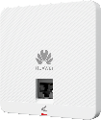
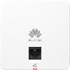
NEW
In-wall AP — eKitEngine AP162E: ultra-high 3000 Mbps speed, ultra-thin body
AP162E
* Suitable for hotels, real estates, and school dormitories
Customer Benefit
Ultra-thin Body
Small size, 8mm panel, Ultra-thin hidden in the wall
AP162E
Ultra- fast and stable
Dual-band 3000M
Video download in seconds and no freezing in games
Green & Eco-friendly
EMC Class B，flame-retardant
9.1 W ultra-low power consumption

Slide 6

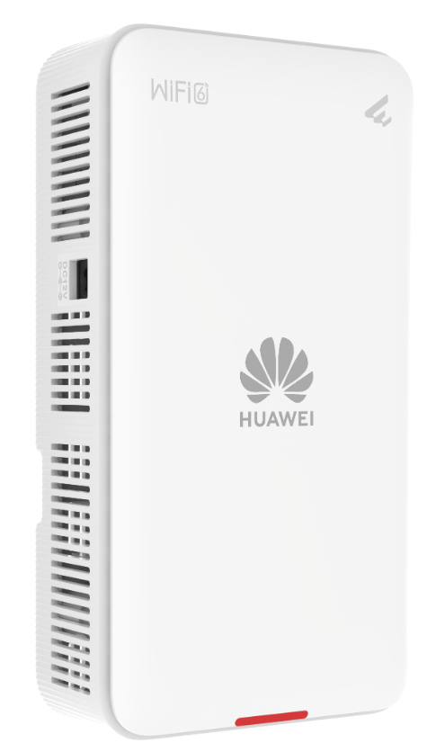

NEW
Multi-port wall plate — eKitEngine AP266: all-scenario wired access & full-room wireless coverage
AP266
POE out
* Suitable for hotels, real estates, and school dormitories
Customer Benefit
All-scenario access
4*GE & PoE-out, all-scenario access for IPTV/PC/IP phone
Green & Eco-friendly
EMC Class B，flame-retardant
9.4 W ultra-low power consumption
AP266
Partner Benefit
Flexible installation
Wall / ceiling / desk / 86-type socket

Slide 7




Wi-Fi 7 settled AP — eKitEngine AP371: Delivering Ultimate Experience
AP371
* Suitable for enterprise office, hotel, education, small hospital, and more
AP371
Customer Benefit
Ultra-fast Network Speed
2 x 2 MU-MIMO, 3.57Gbps data rate
Up to 2.5GE uplink
30% Larger Coverage Range
The seventh generation of Wi-Fi standard, driving the future, with smart antennas
Ultra-low Latency of 2 ms
High throughput and low latency for real-time interactions (AR/VR)

Slide 8


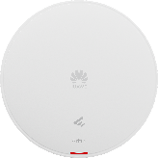
High Density Settled eKitEngine AP661：50% more access user, ultra-far coverage
AP661
AP661
* Suitable for Banquet Hall, Conference Room, Auditorium and more
Customer Benefit
Ultra-multi access
2.4G+5.2G+5.8G triple-RF design, 50% more user access than industry
Ultra-far Coverage
Smart antenna, signals move with users for continuous coverage;
Signal strength doubles, coverage radius increase 15 meters
Ultra-high Bandwidth
6.5Gbps wireless bandwidth，2.5G+1G dual ports uplink，2 times of industry

Slide 9


NEW
High density Wi-Fi 7 AP — eKitEngine AP673：triple-radio, 300+ concurrent access
AP673
AP673
* Suitable for banquet hall, conference room, auditorium and more
Customer Benefit
Extra-high performance
data rate up to 13.66 Gbps
High density
Triple-Radio, 300+ concurrent access
High reliability
MLO — a Wi-Fi 7 exclusive feature, tripled reliability

Slide 10

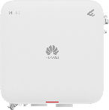
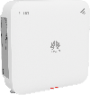
Outdoor eKitEngine AP761：IP68 grade protection, no fear of harsh environment
AP761
AP761
* Suitable for outdoor, cold store, factory and more
Customer Benefit
Ultra-strong protection
IP68 waterproof and dustproof, works in a temperature range of -40°C to +65°C, adapts to all weathers
Smart Mesh
App easy click to setup wireless mesh eliminating high cost cabling
Ultra-far backhaul
1*GE SFP + 1*GE copper ports, no fear of long distance backhaul

Slide 11




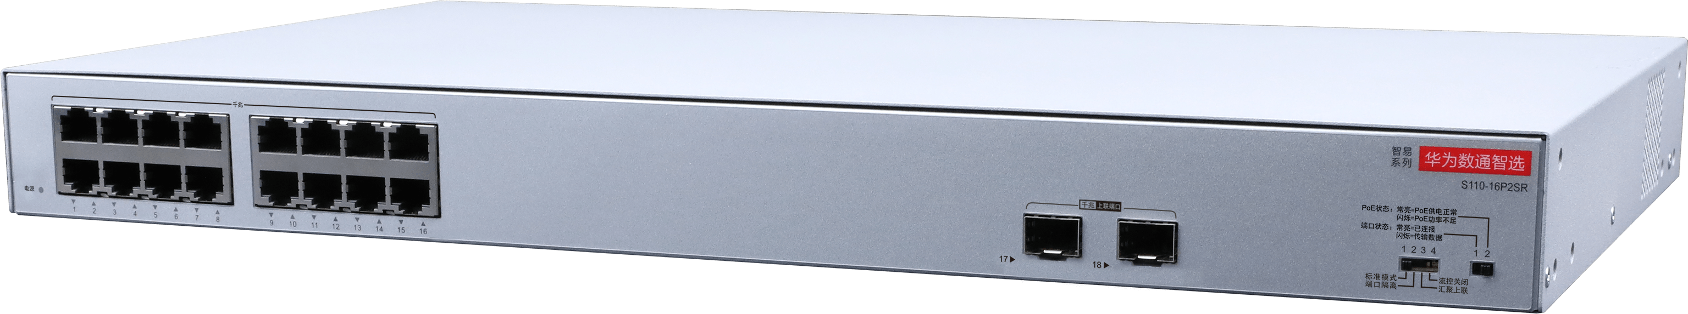
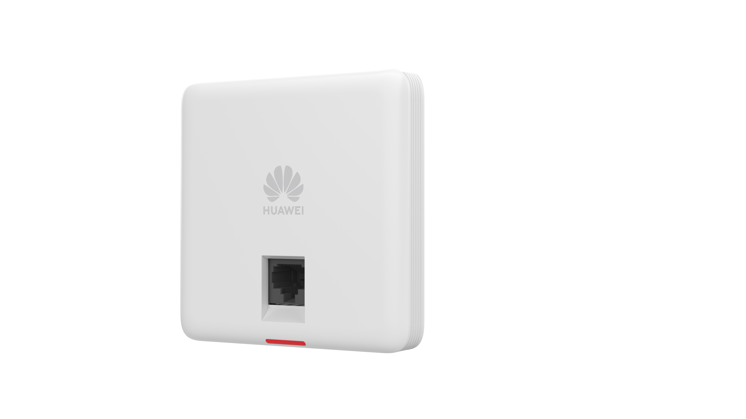

High Reliability Multi-function Gateway AR720： All-in-one gateway
AR720
* Suitable for enterprise office, stores, budget hotels, and more
Customer Benefit
Key service assurance
Key service assurance, such as video conference
Partner Benefit
AR720
Outstanding performance
Supports automatic failover and load balancing for links of multiple ISPs
All-in-one gateway for routing, switching, VPN, AV, IPS function, 1U device saves rack space

Slide 12
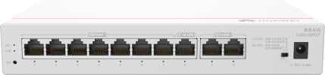

All-Round Product eKitEngine S380: Routing + Switching + WAC
S380
* Suitable for enterprise office, stores, budget hotels, and more
3 in 1 device
Integration of multiple functions such as routing, switching, and WAC
Cost-effective, 30% lower TCO for enterprises, meeting enterprise digitalization requirements in multiple scenarios
Customer Benefit
Outstanding performance
Multi-core forwarding architecture, 2 Gbit/s egress bandwidth, 1.5x performance of industry peer products
Number of connected terminals: 500, meeting multi-service requirements of SMEs
S380
Simple configuration
Overall network deployment by scanning the code
Wizard-based configuration on Easy Web, making local deployment easy
Partner Benefit

Slide 13




Core Switches eKitEngine S530: Dedicated stack ports, flexible service expansion
S530
S530
* Suitable for K-12 school, budget hotel, factory and more
Customer Benefit
High Reliability
Fan & pluggable power modules redundancy
Intelligent Stack
Dedicated stack ports, configuration-free
Enhanced L3 Capability
OSPF, ISIS, BGP, VRRP
Simplified O&M
APP deployment by scanning the code
Wizard-based configuration on Easy Web
Dedicated stack ports, facilitating configuration-free stacking
Partner Benefit

Slide 14



NEW
Hybrid 10GE core switch eKitEngine S620: rich ports and functions, ultra-high reliability
S620
S620
* Suitable for medium-sized enterprises, medium-sized hotels, schools, factories and warehouses
Customer Benefit
Ultra-flexible networking
GE/10GE/40GE/100GE ports, adapting to more services
Ultra-rich features
L3 features such as OSPF, IS-IS, BGP and VRRP, supporting various voice, video, and data applications
Ultra-reliable design
Service port stacking
power modules and fan modules 1+1 redundancy

Slide 15




Layer 3 Switch — eKitEngine S310: Enhanced Stacking and Network Stability
S310
* Suitable for office, K-12 school, small hospital, and more
Customer Benefit
Enhanced features
Heavyweight feature stacking and ERPS, 2X Network Stability
S310
Various models
24/48 ports (PoE+), GE/10GE uplink, suitable for all scenarios
Partner Benefit
Simplified O&M
APP deployment by scanning the code
Wizard-based configuration on Easy Web, making local deployment easy

Slide 16



NEW
Economical L2+ switches S310S: richer in functions than L2 switch, and more cost-effective than L3 switches
S310S
* Suitable for SMEs, Schools and Hospitals
S310S
Rich L3 functions
Support static routing and policy-based routing
Customer Benefit
Differentiated ports
2.5GE vs GE access
avoiding homogeneous competition
Partner Benefit
Simplified O&M
App, cloud platform, or web

Slide 17

Enhanced Layer 2 Switch — eKitEngine S220: Easy Web for Effortless Management
S220
* Suitable for enterprise office, K-12 school, small hospital, and more
Customer Benefit
Perpetual PoE
Device restart without power interruption.
Compatible with hundreds of PDs, suiting devices from different vendors
S220
Partner Benefit
Simple configuration and maintenance
APP deployment by scanning the code
Wizard-based configuration on Easy Web, making local deployment easy

Slide 18
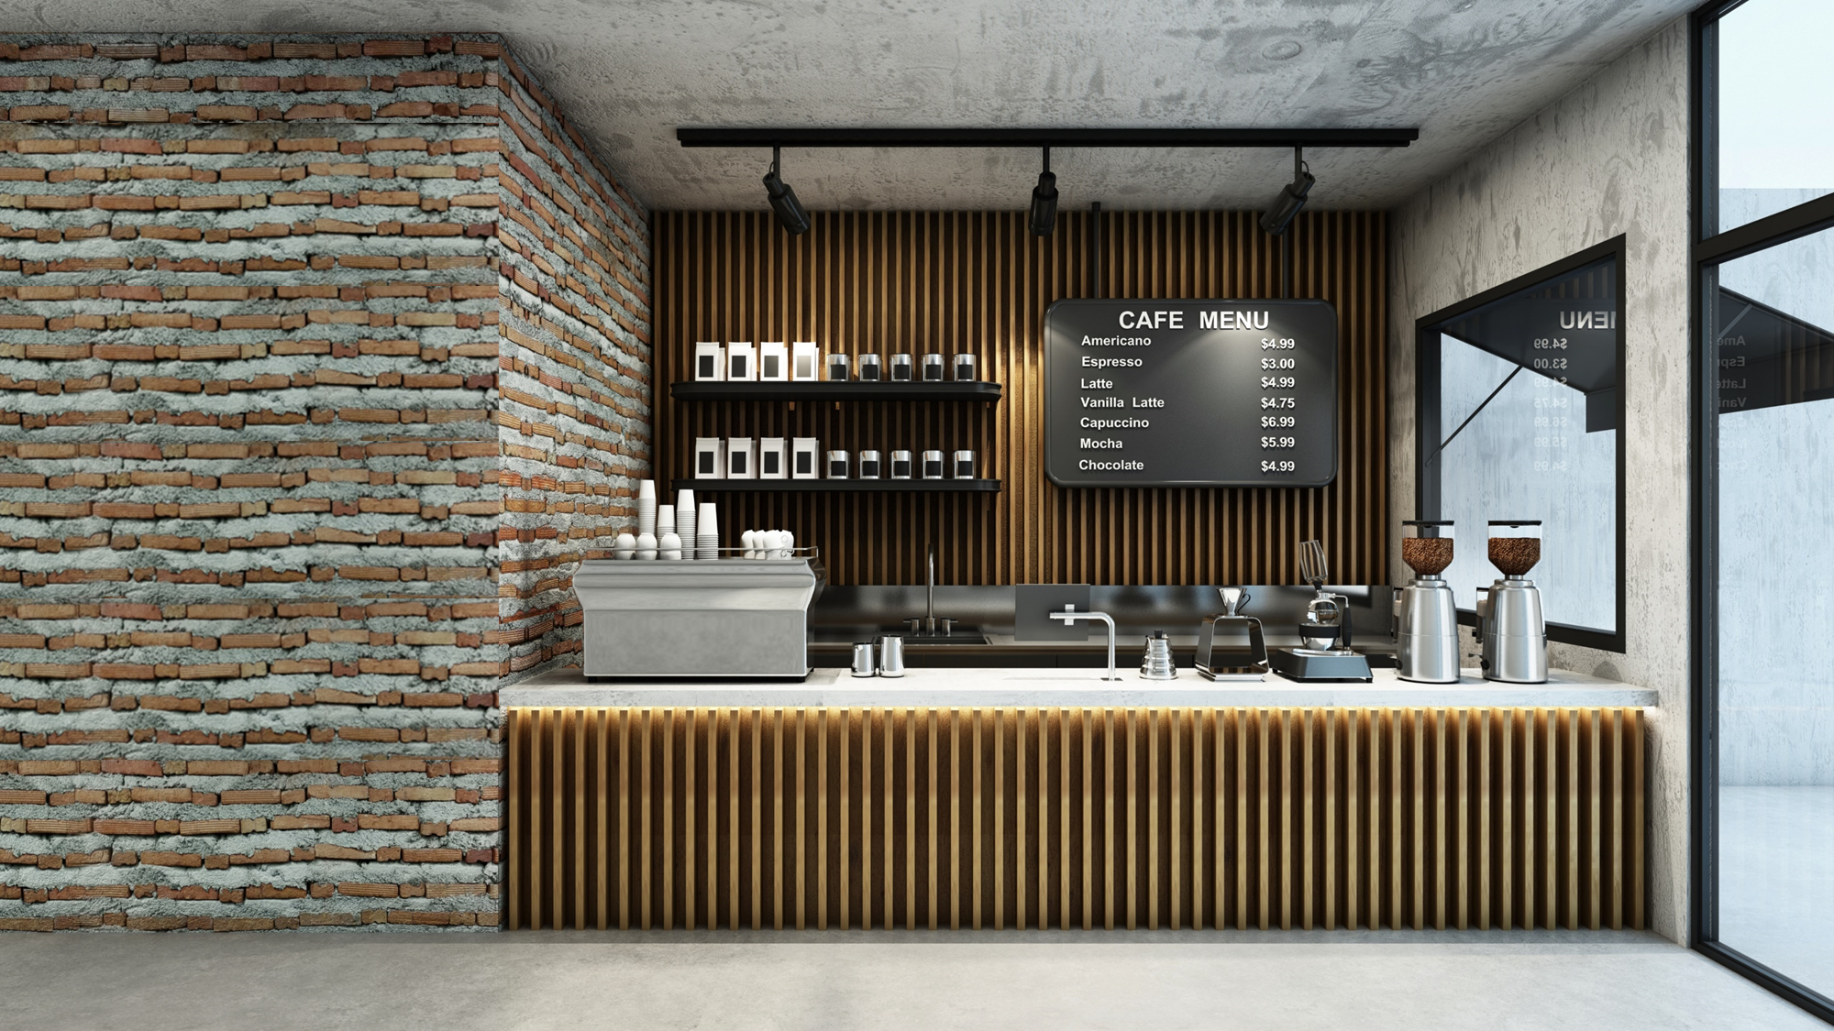
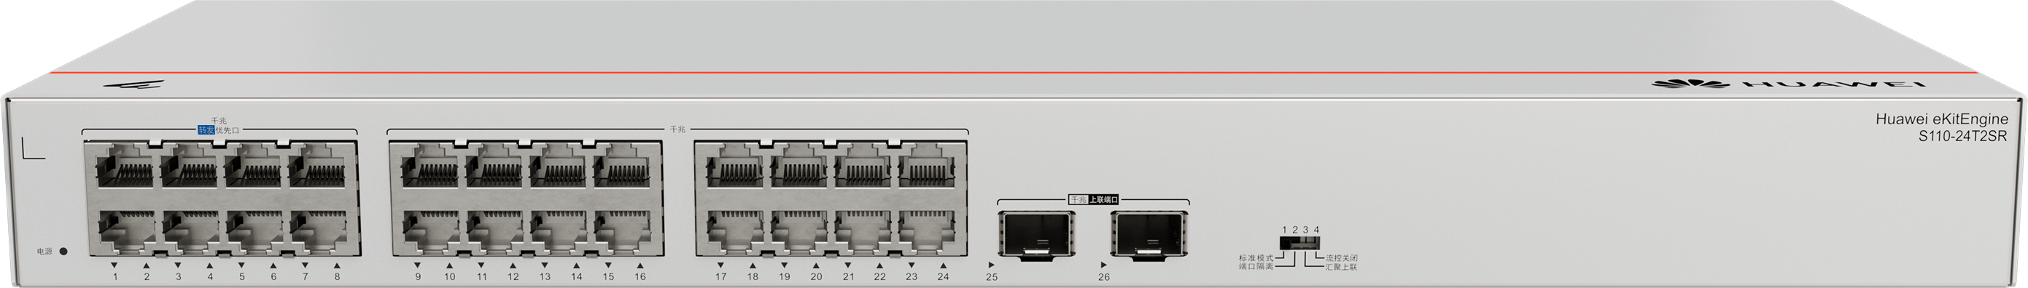
Unmanaged Switch — eKitEngine S110: 4 DIP Switches, Easier Management
S110
* Suitable for store, real estate, and more
Partner Benefit
4 DIP switches
Four typical modes for easier management
Customer Benefit
Perpetual PoE
Device restart without power interruption.
Compatible with hundreds of PDs, suiting devices from different vendors
S110
Noise-free and energy-saving
Fan-free design, quiet, energy-saving, and eco-friendly

Slide 19





NEW
Economical L2 switch S220S: differentiated port access, upgrade to 2.5GE networking without device replacement
S220S
Suitable for SMEs, commercial stores and hotels
Customer Benefit
Differentiated ports
2.5GE vs GE access
avoiding homogeneous competition
Always-on PoE
Compatible with non-standard PDs
Uninterrupted power supply during switch restart
S220S
Partner Benefit
Simplified O&M
App, cloud platform, or web

Slide 20
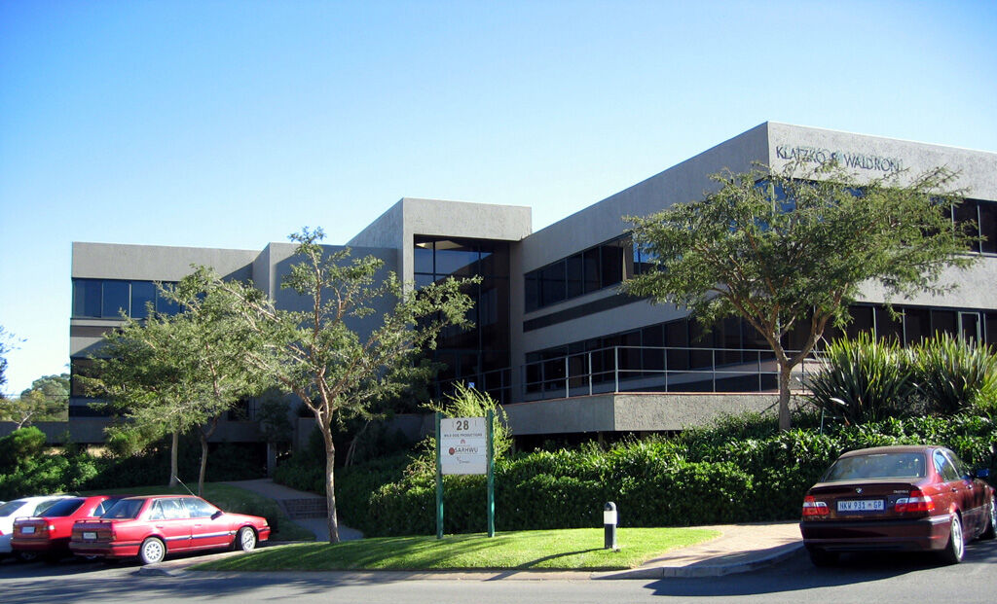




Next-Generation Multi-Service AI Firewall - USG6300E-S
USG6300E-S series AI firewall
The USG6300E-S series applies to small and midsize enterprises, retail e-commerce branch interconnection, and border security scenarios.
Simplified
O&M
On-demand subscription
Border protection and response service
Intrusion detection and prevention, AI-based automatic analysis, and 24/7 expert O&M on the cloud.
Security expert service
AI-based automatic threat analysis
Higher time efficiency
The USG6300E-S series applies to network security construction scenarios such as district/county hospitals, education campuses, and digital office.
Security competence center
Cost-effective
Two-fold computing power improvement, integration of multiple security services,
and all-in-one firewall, reducing Investment and simplifying O&M
For customer
Deliver threat blocking instructions
Send collected logs and information
Huawei firewall/Qiankun Shield
Interworking with the Huawei Qiankun platform, comprehensive threat detection rate > 96%
Huawei firewall: collection/detection/blocking
Easy
Threat visualization, attack source tracing, health scoring, and report analysis
Government office campus
Enterprise campus
Production campus
Education campus
Fast
Simple deployment in four steps, and intelligent deployment of security policies
For subcontractor

Slide 21
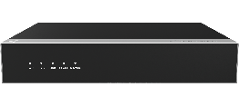

eKitEngine USG6000E-S03/13: Next-Generation Intelligent Firewall, Energy-Saving, Efficient, Safeguarding Your Network
USG6000E-S03/13
* Suitable for enterprise office, K-12 school, small hospital, and more
Customer Benefit
Most Reliable
Carrier-class ultra-reliable software and hardware, designed and manufactured by Huawei, ensuring zero service interruption
Excellent performance
Dedicated security chip, CPU computing power + hardware acceleration, network and threat processing performance improved by 3 to 5 times, environmental protection, energy saving by 30%, and lowest defense cost per bit
USG6000E-S13
Intelligent defense
85+% IPS automatic handling rate, 500+ million URL category database, and detection of packed viruses and unknown malware
Specific areas can be associated with Qiankun Cloud. The security capability center, AI analysis, and cloud experts reduce security O&M costs by 80%.

Slide 22

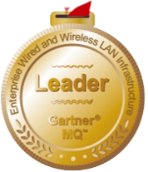

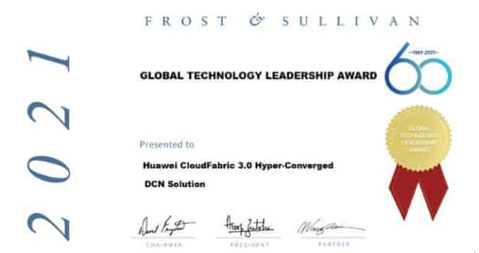



Huawei eKit SME Network, Starting from China, Provides High-Quality Products That Are Easy to Install and Maintain for Global Partners and Customers
10
shipping centers
1 million+
accumulated shipments
20+
countries and regions
MQ leader, the only non-North American vendor
Customer's choice: No. 1 in overall customer rating
Global Wi-Fi 6 Market Leadership Award
Global New Product Innovation Leadership Award
Global Technology Leadership Award
AirEngine Wi-Fi 6: Grand Prize
NetEngine: Special Prize

