Slide 1


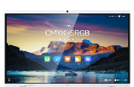
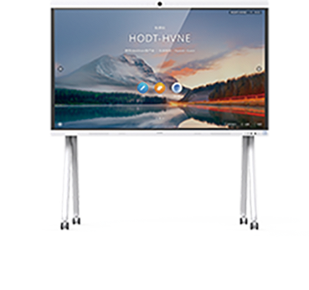
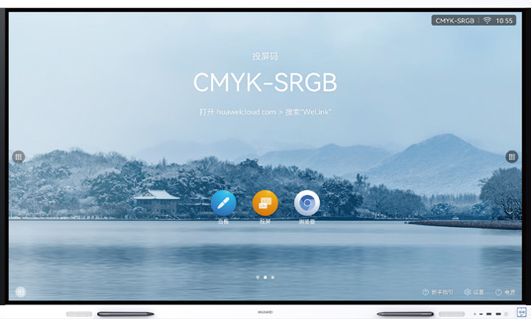
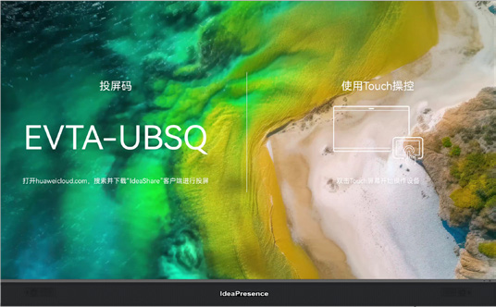


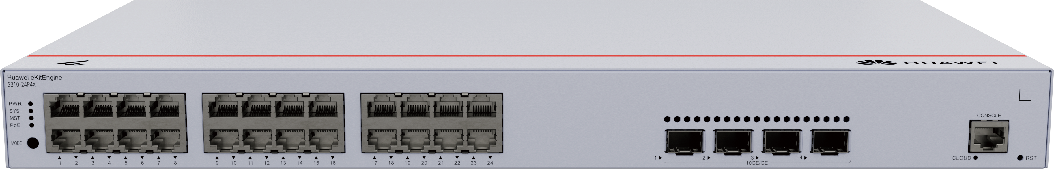
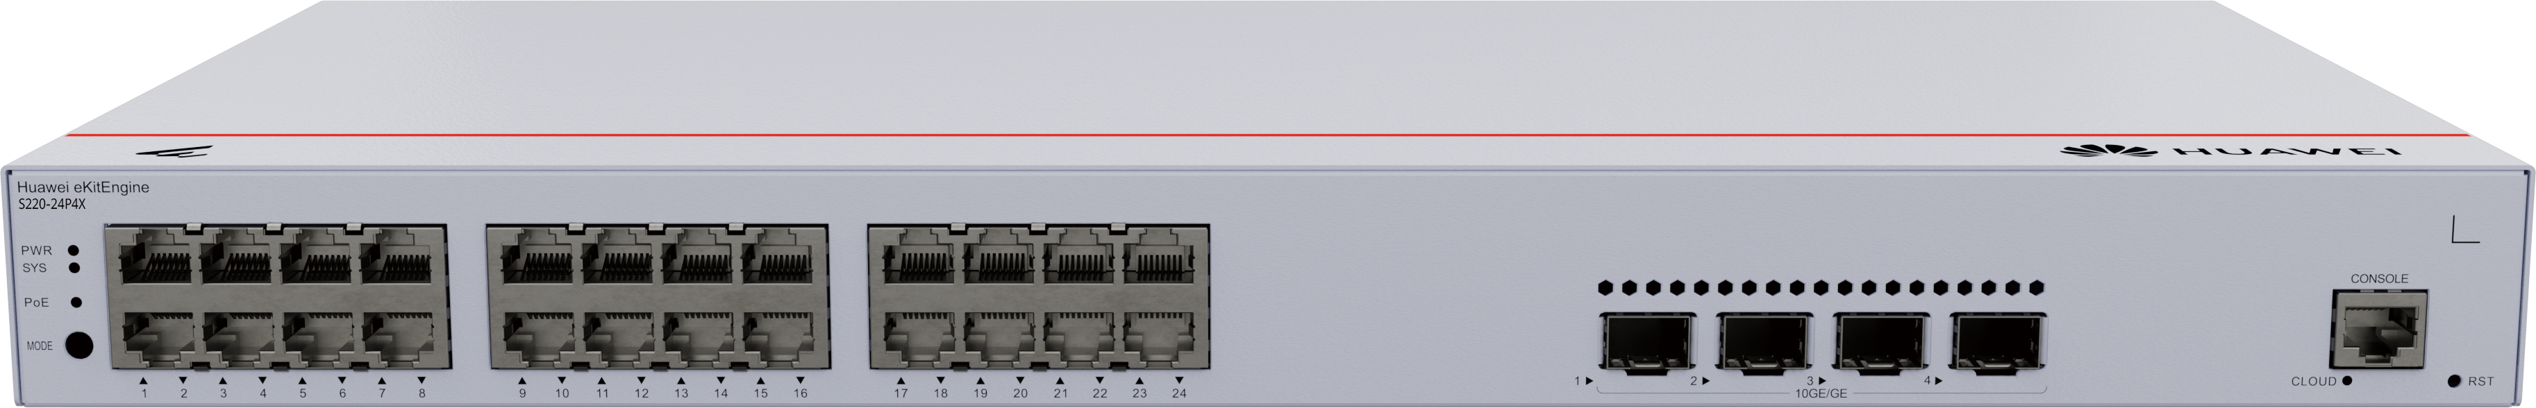
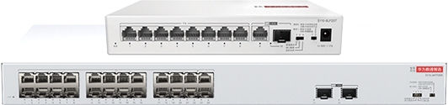

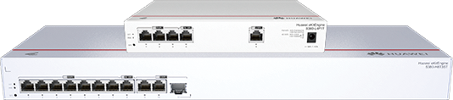
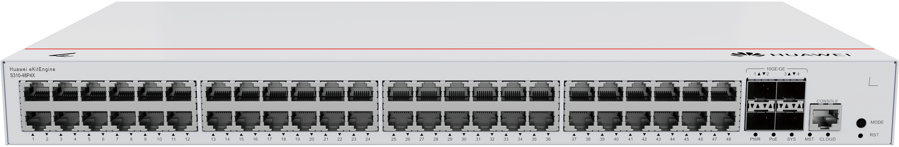
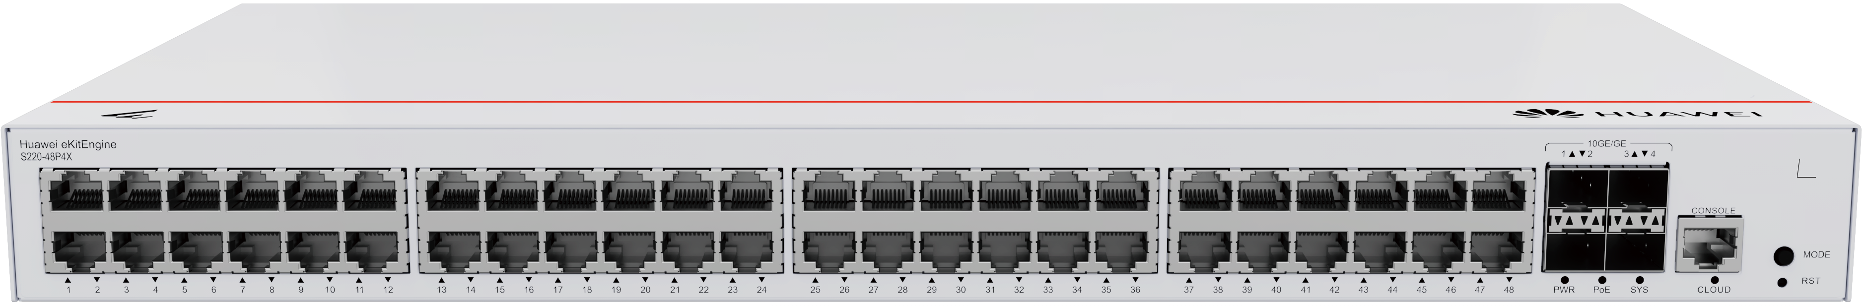

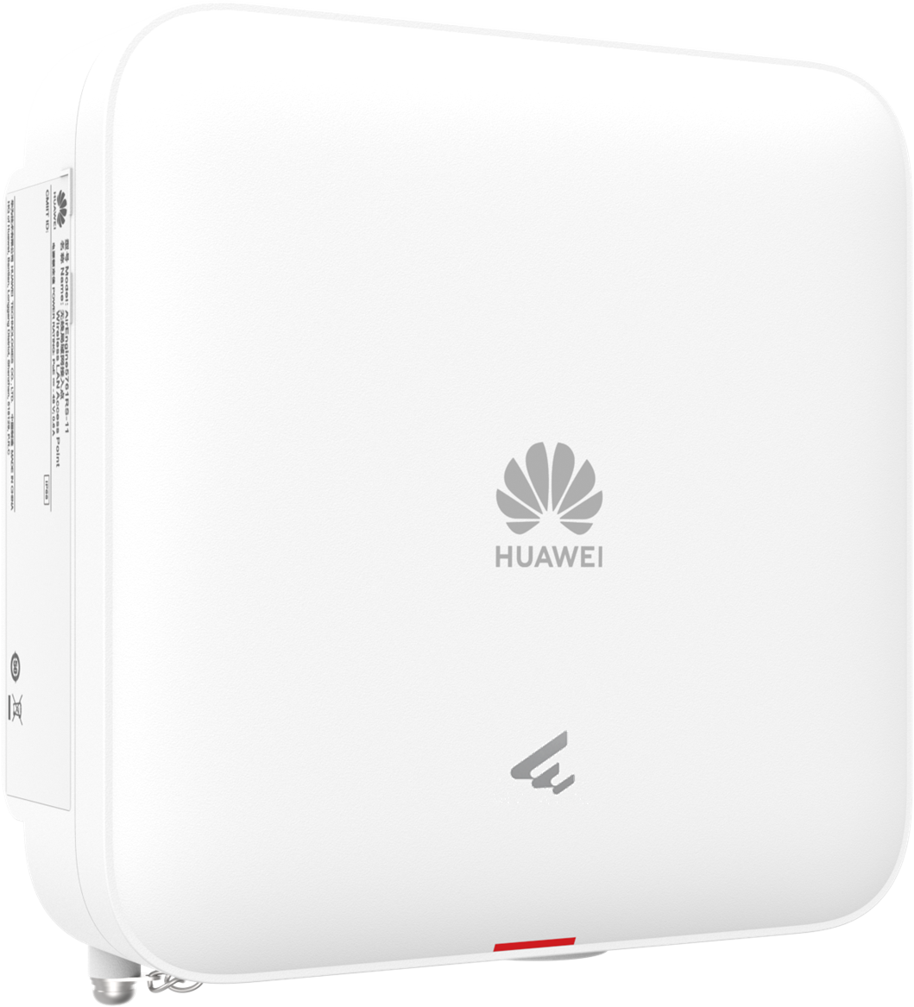


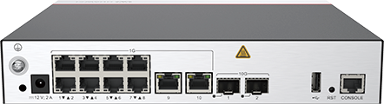

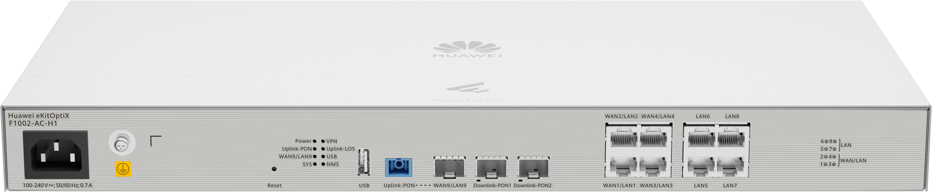

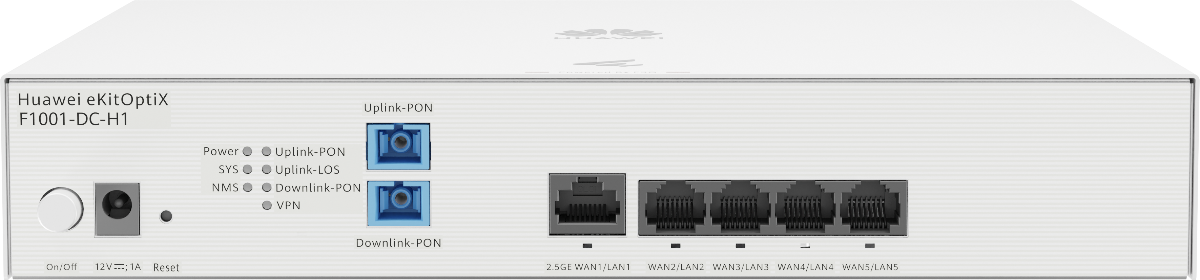






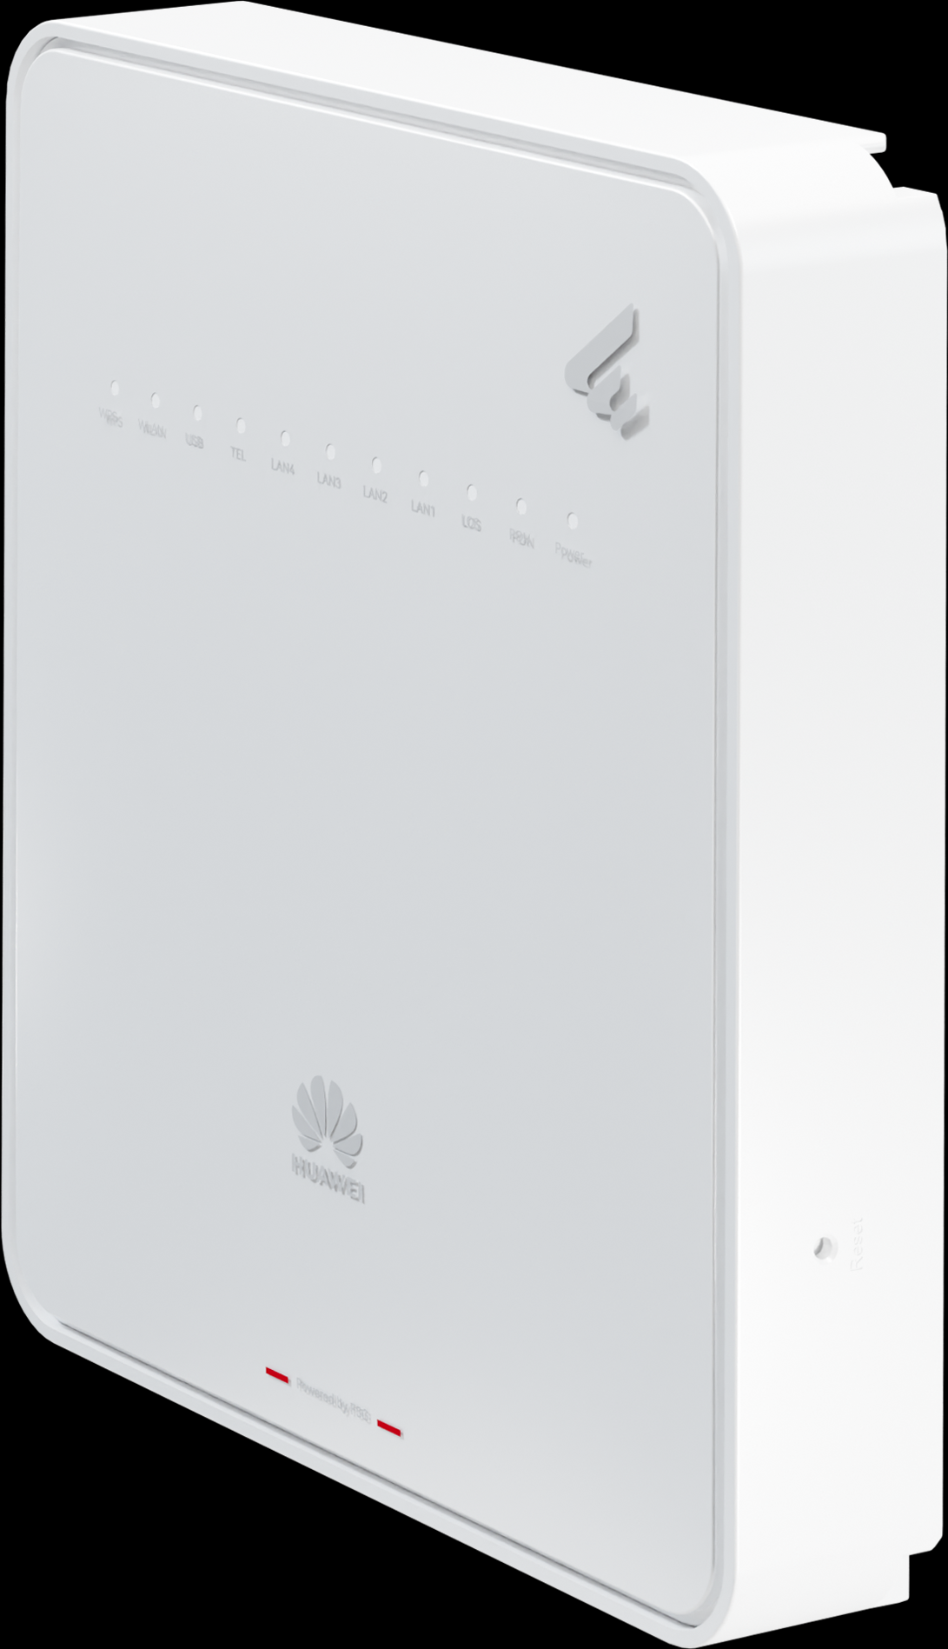
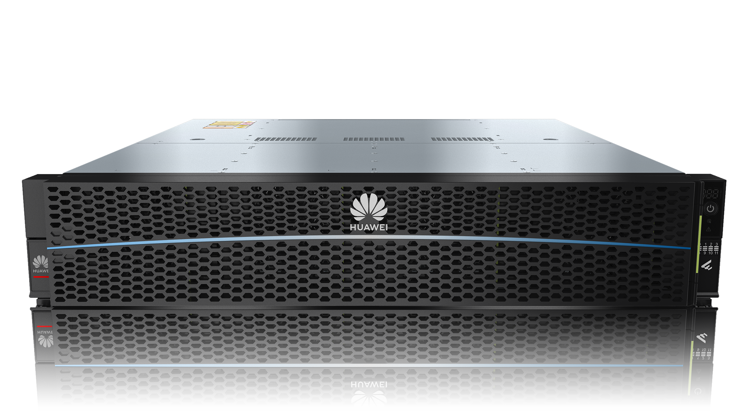
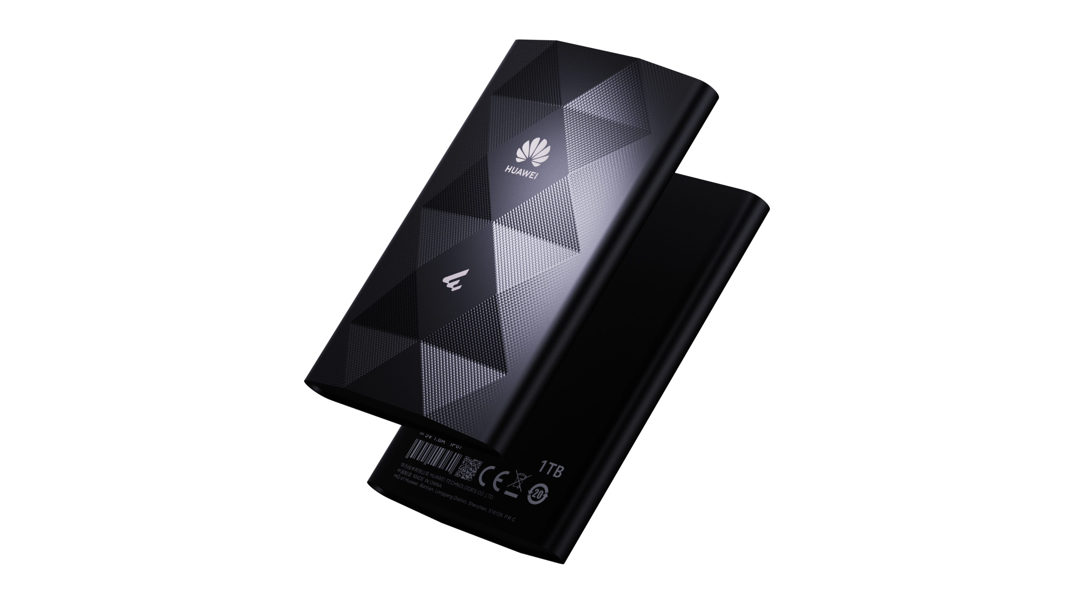
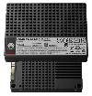
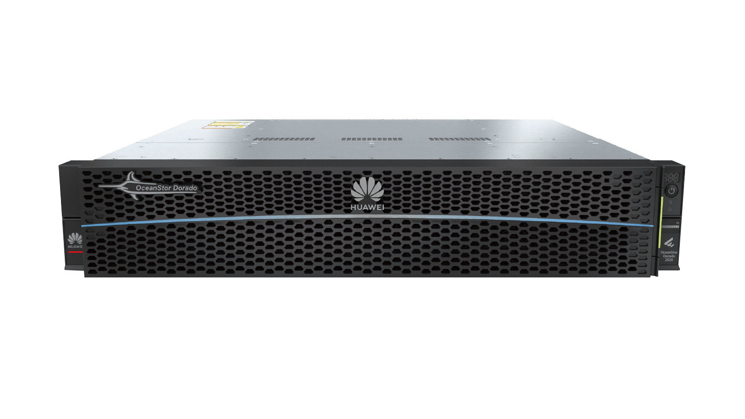
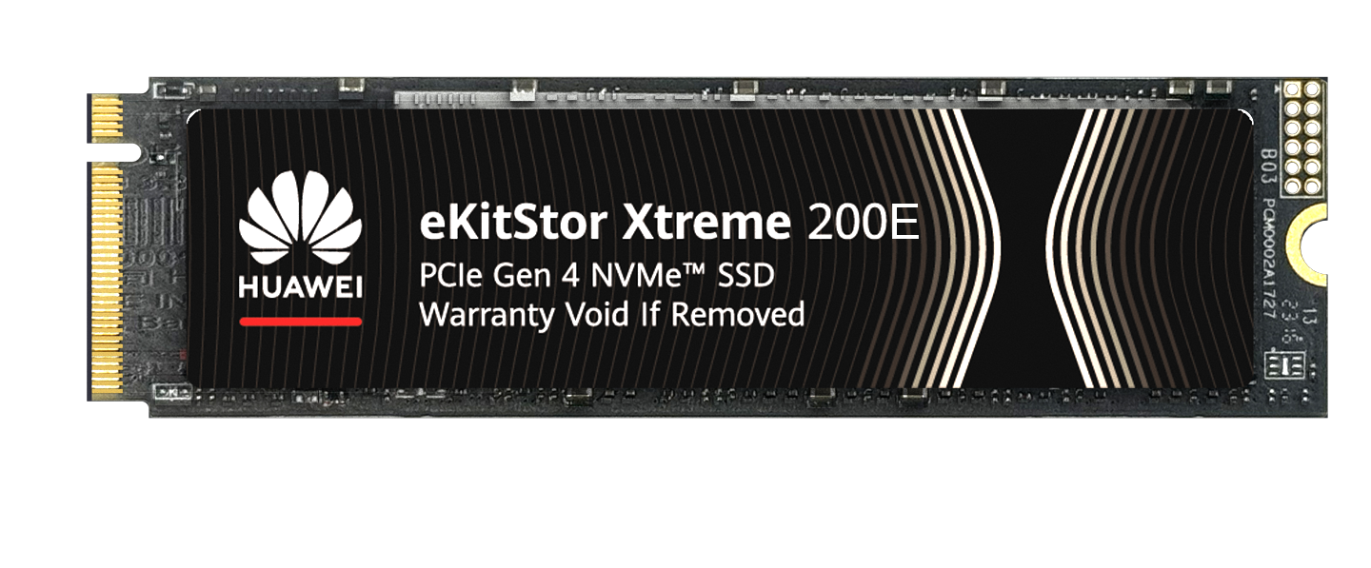
HUAWEI eKit Product Portfolio
Various intelligent devices
IdeaHub
IdeaPresence
Intelligent Collaboration
13 models
S2 (65′75′86′)
B3 (65′75′86′)
B2 (65′75′86′)
Board 2 (65′75′86′)
IdeaPresence 138
Switches
Routers
Innovative wired+
wireless connectivity
Firewalls
S620 series
Core Switch
S530 series
Core Switch
S310/S310S series
L3 fully-managed
S220/S220S series
L2 fully-managed
S110 series
Unmanaged Switch
AR300 series
Converged gateway
AR700 series
Converged gateway
S380 series
Converged gateway
SME Network
71 models
WLAN
USG6000E-S03
Desktop model
USG6300E-S13
Rack-mount model
AP673/371
Wi-Fi 7 AP
AP761
Outdoor AP
AP661
High-density AP
AP362/362E/361
Settled AP
AP266/265E/263
Wall plate AP
AP160/162E
AC650
WLAN Controller
Optical gateway
Optical terminals
Optical APs
MiniFTTO
10 models
Highly efficient IT platform
F1002-AC-H1
F1001-AC
F1001-DC-H1
F200D-8P
F200D-8G
F100D-4G
F100P-2G
F600C
F600D
F500D
Entry-level storage
Entry-level storage
eKitStor SSD
Data Storage
19 models
OceanStor Dorado 2020
All-Flash Storage
OceanStor 5120/5220
New-Gen Hybrid Flash Storage
eKitStor Xtreme 200E
M.2 NVMe SSD
eKitStor Shield 210
highly protected portable SSD
eKitStor Xtreme 300
U.2 SSD
Notes:
AP160 4色的
397款 = 287款 + 110款
397+18 = 415
287+18 = 305
Q1 数量:18
安全：8+2 款
数通：4款
光：3 款
行业感知：1款
存储：0
协作：0
计算：0
HCS：0、光场屏：0

